Slide 1
More than a child
Luke 2:1 - 20

Slide 2
More than a child
Jesus as a Baby – Luke 2:1 - 7
A normal birth
Born into a poor family
The appearance of illegitimacy
see also John 8:41

Slide 3
More than a child
Jesus as Creator – John 1:1 – 3
A normal human body contained the Creator of the world
The Word is Jesus
John 1:14
Without Him nothing was made

Slide 4
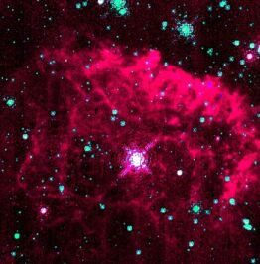

Slide 5
More than a child
Jesus as Dying Saviour – Luke 2: 8- 12
The shepherd’s reaction
What would this child save us from?
1 Peter 2:24
Dying so that we might live

Slide 6
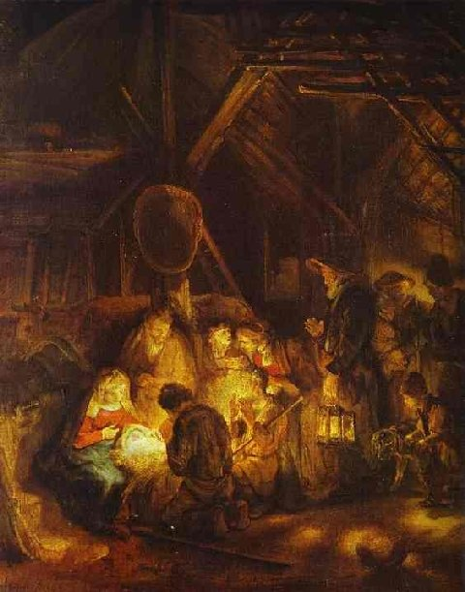

Slide 7
More than a child
Jesus as Empowering Lord
He enables us to become His beloved people – Galatians 2:20
Jesus is alive for evermore
The living empowering Lord is within us

Slide 8
More than a child
Jesus as Final Judge and Returning King
The judge of all mankind
Rev 19:11 – 16
The promise of a new heaven and earth
Rev 21:1 - 7
Everyone will not be saved
Rev 21:8
Where do you stand?

